Slide 1







Computer Algorithm
Complexity Classes
Presented by:​
🔹Prottoy Sarker
(ID: 241311062)​
Presented by:​
🔹Abdullah Al Mahfuz
(ID:241311058)​

Slide 2


Introduction to Complexity:
🔹 What is Complexity?
Complexity shows how difficult a problem is for a computer.
It measures how much time and memory an algorithm needs to solve a problem.

Slide 3
Types of Complexity:
“There are two main types:
Time complexity means how long an algorithm takes to run, and space complexity means how much memory it needs. When our input grows bigger, both time and space also grow — that’s why studying complexity is so important.”

Slide 4
Asymptotic Notations:
To describe algorithm performance mathematically, we use special symbols: Big O for the worst case, Omega for the best case, and Theta for the average or exact case. For example, a loop running ‘n’ times has O(n) complexity — meaning it grows linearly with input size

Slide 5
What Are Complexity Classes?
They are groups of problems divided by how difficult they are to solve. Some problems can be solved very fast, while others take huge amounts of time — and these classes help us understand that difference.

Slide 6
Common Complexity Classes:
P – Polynomial Time
NP – Non-deterministic Polynomial Time
NP-Complete – Hardest problems in NP
NP-Hard – Problems at least as hard as NP-Complete

Slide 7

Detailed Explanation of Complexity Classes:
Class P (Polynomial Time):
Class P contains all the problems that can be solved efficiently — in polynomial time. For example, sorting numbers or finding the shortest path in a graph. These problems are easy both to solve and to verify, so they are considered ‘feasible’ for computers.

Slide 8
Class NP (Nondeterministic Polynomial Time):
These are problems that are easy to check but hard to solve. If someone gives you the answer, you can verify it quickly — but finding that answer by yourself might take a very long time. Sudoku is a great example — checking a solution is easy, but solving it can take hours.

Slide 9
Class NP-Hard:
NP-Hard problems are at least as hard as NP-Complete problems, and sometimes even harder. They might not even have a quick way to verify the solution. For example, the optimization version of the Traveling Salesman Problem or the Halting Problem. These problems are generally considered impossible to solve efficiently.

Slide 10
Class NP-Complete:
NP-Complete problems are the hardest problems inside NP. They are both in NP, and as hard as any other NP problem. That means if we could solve even one NP-Complete problem quickly, then we could solve all NP problems quickly. Examples include the 3-SAT problem, Knapsack, and Traveling Salesman (decision version).

Slide 11
Relationships Between Classes:
Here’s how all these classes connect. P is a subset of NP, NP-Complete lies inside NP, and NP-Hard includes everything that’s as hard or harder. The big unsolved question in computer science is — is P equal to NP? If yes, it would change everything about how we solve problems.

Slide 12
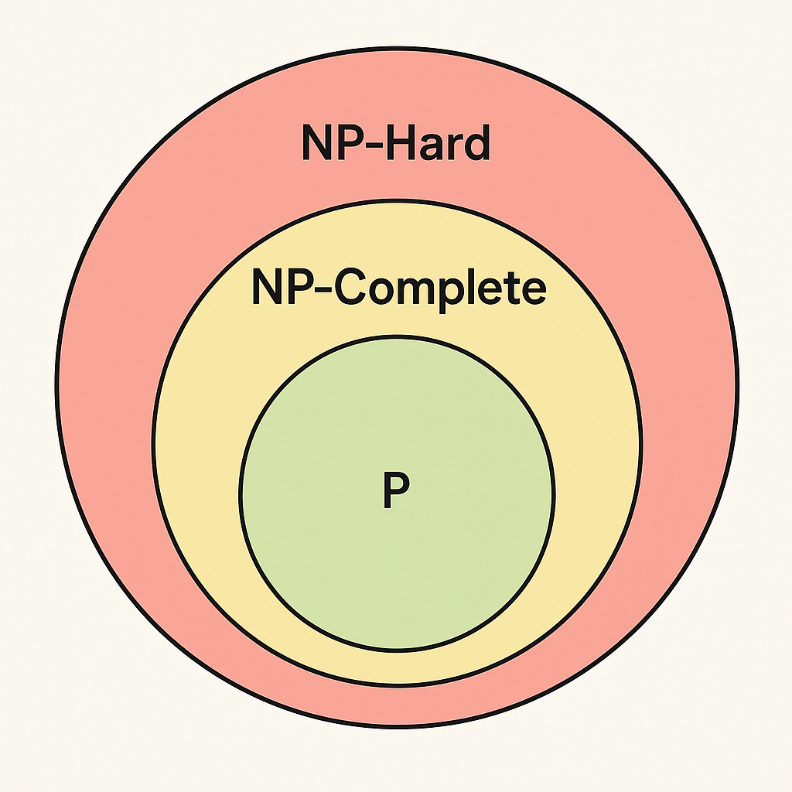
Diagram Representation:
This diagram shows the relationship visually. The smallest circle is P — easy problems. NP includes both easy and hard-to-solve but easy-to-check problems. NP-Complete sits at the edge of NP, being the hardest inside it. And NP-Hard is the outer layer, containing the toughest of all problems.

Slide 13
Real-World Examples:
Let’s look at some real-world examples. Sorting and searching are P problems — easy for computers. Sudoku is NP — difficult to solve but easy to check. 3-SAT or Knapsack are NP-Complete — extremely hard. And optimization problems like TSP or Halting Problem are NP-Hard — often impossible to solve efficiently.

Slide 14
Simple Code:
#include <bits/stdc++.h>
using namespace std;
vector<vector<int>> adj;
vector<int> hasCat;
int m; // max consecutive cats allowed
int n; // number of nodes
int result = 0;
void dfs(int node, int parent, int consecutive) {
if (hasCat[node]) consecutive++;
else consecutive = 0;
if (consecutive > m) return; // invalid path
bool isLeaf = true;
for (int neighbor : adj[node]) {
if (neighbor != parent) {
dfs(neighbor, node, consecutive);
isLeaf = false;
}
}
if (isLeaf) result++; // valid leaf path
}

Slide 15

.
int main() {
ios::sync_with_stdio(false);
cin.tie(0);
cin >> n >> m;
hasCat.resize(n + 1);
adj.resize(n + 1);
for (int i = 1; i <= n; i++) {
cin >> hasCat[i]; // 1 if node has cat, 0 otherwise
}
for (int i = 0; i < n - 1; i++) {
int u, v;
cin >> u >> v;
adj[u].push_back(v);
adj[v].push_back(u);
}
dfs(1, 0, 0); // start DFS from node 1
cout << result << "\n";
return 0;
}

Slide 16
Complexity Analysis:
Time Complexity:
Building Tree (Adjacency List): O(n)
DFS Traversal: Each node & edge visited once → O(n)
Overall: ✅ O(n)
🔹 Efficient for n ≤ 10⁵ 🔹 Each vertex processed once
Space Complexity:
Adjacency List: O(n)
DFS Recursion Stack: O(h) (≤ O(n))
Cat Array & Other Variables: O(n)
Overall: ✅ O(n)
🔹 Linear space usage 🔹 Depends on tree height

Slide 17

“Thank you for listening.”
✅References:
"M. Sipser, Introduction to the Theory of Computation, 3rd Ed., 2012" "S. Arora & B. Barak, Computational Complexity: A Modern Approach, 2009"

